Slide 1
Software Architecture Process

Slide 2
Architectural Analysis
Define the problems the architecture must solve.
Village – don’t build roads before understanding where people need to go.
Inputs:
Architectural Concerns: Stakeholders’ interests that can impact arch decisions
  e.g., hospital management system, what are stakeholders & interests?
    doctors – usability
    admins – log audit for compliance
    patients – secured access to PII
  ignored – costly redesign later

Slide 3
Architectural Analysis
Define the problems the architecture must solve.
Village – don’t build roads before understanding where people need to go.
Inputs:
Context: environment that will influence the system
  Ride-sharing application
  Developmental – team skills, available tools, budget constraints
    e.g., team has a lot of expertise in Java, almost none in Go
  Operational – expected workload, runtime env, deployment platform
    e.g., must handle large events (as concerts) – in one area, not just in total
  Political – company strategy, external regulations, stakeholder / department conflicts
    e.g., must store user data in their country – legal regulations
  etc

Slide 4
Architectural Analysis
Define the problems the architecture must solve.
Village – don’t build roads before understanding where people need to go.
Output:
Architecturally Significant Requirements: requirements that influence architecture
  e.g.,
    performance – must handle 50k concurrent users
    security – must be HIPAA compliant
    availability – must achieve 99.99% uptime

Slide 5
Architectural Synthesis
Proposes architectural solutions to a set of ASRs
Village – sketch possible routes to solve main problems
Input:
Architecturally Significant Requirements – constraints & drivers
  ASR: must handle 50k concurrent users
    => distributed, scalable architecture
  ASR: must comply with HIPAA
    => secure data storage & audit logs
No ASRs – arbitrary decisions / devs preferences

Slide 6
Architectural Synthesis
Proposes architectural solutions to a set of ASRs
Village – sketch possible routes to solve main problems
Output:
Candidate Architectural Solutions: specific design solution
  Not necessary final
  Look realistic & feasible
  Multiple can exist
  e.g., real-time chat application – what are possible approaches?
    Candidate 1 – monolith with WebSockets
    Candidate 2 – microservices with Kafka and push-notifications

Slide 7
Architectural Synthesis
Proposes architectural solutions to a set of ASRs
Village – sketch possible routes to solve main problems
Typical choices:
  Structural
    layered vs hexagonal
    client-server vs peer-to-peer
      e.g., torrent protocol to distribute data across services
  Technological
    Relational vs NoSQL
    REST vs gRPC
  Cross-cutting
    sticky sessions, OAuth2, JWT
    Logging & monitoring frameworks

Slide 8
Architectural Synthesis
Proposes architectural solutions to a set of ASRs
Village – sketch possible routes to solve main problems
Trade-offs:
  Always present
    “It depends” ©
  Generate multiple candidates
  Evaluate & choose later

Slide 9
Architectural Evaluation
Ensure that the made architectural decisions are the right ones
Goal – verify alignment between ASRs & candidates
Village – check costs, safety, terrain & traffic before deciding what to build
Inputs:
Architecturally Significant Requirements – non-negotiable rules
Candidate Architectural Solutions

Slide 10
Architectural Evaluation
Some techniques:
  Scenario-based analysis
    stress-test against hypothetical situations
    find scenarios where system fails
    e.g., sudden traffic spike due to a marketing campaign
  Architecture trade-off analysis
    find negative sides of architecture benefits
    will it affect ASRs?
    e.g., a lot of caching -> faster responses -> weaker consistency
  Prototyping
    build a throwaway prototype to test hypotheses
    e.g., check if the architecture & technologies withstand Nk concurrent users
  Stakeholder review
    different stakeholders focus on different aspects
    warning – some stakeholders are not technical

Slide 11
Architectural Evaluation
Ensure that the made architectural decisions are the right ones
Goal – verify alignment between ASRs & candidates
Village – check costs, safety, terrain & traffic before deciding what to build
Outputs:
Validated Architecture: subset of candidate architectures consistent with ASRs
  some eliminated
  some improved

Slide 12
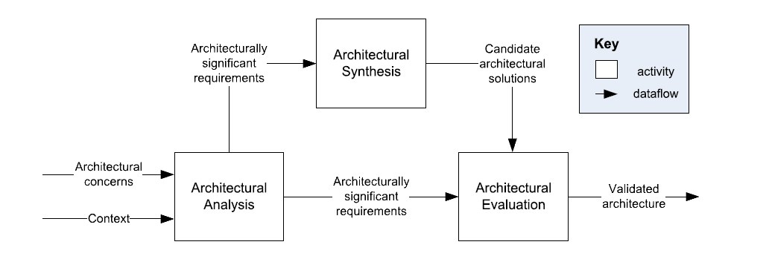
A General Architecture Process Model
C. Hofmeister, et al., A general model of software architecture design derived from five industrial approaches, Journal of Systems and Software, 80:106-126, 2007.

Slide 13
Repeatable Processes for Software Architecture
Repeatability – produce systematic results, not accidental (engineering)
Virtually every architectural methodology includes:
  understanding the problem, gathering ASRs – analysis
  proposing solutions – synthesis
  validate against requirements – evaluation
Village – study, propose routes, test routes (country road or highway)
Examples:
  Attribute-Driven Design
  RUP 4+1 Views
  Business Architecture Process and Organization (BAPO/CAFCR)
No one process is best – each has its strengths and weaknesses.

Slide 14
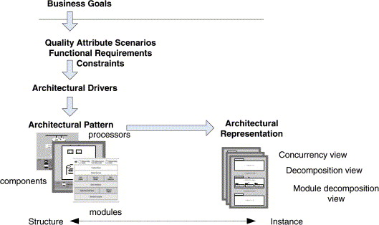
Attribute Driven Design
Built around arch drivers (created from reqs)
Pros
  Traceable – every decision links to a driver
  Requirements explicitly shape an architecture
Cons
  Can overfocus on non-functional requirements

Slide 15
Design Purpose
Primary Functionality
Quality Attributes
Constraints
Architectural Concerns
Step 1: Review Inputs
Step 2: Establish Iteration Goal
Step 3: Choose Elements to Refine
From previous round of iterations OR from existing system
Step 4: Choose Design Concepts
Iterate if necessary
Step 5: Instantiate Architectural Elements
Step 6: Record Design Decisions
Step 7: Review Design
(Refined) Software Architecture Design

Slide 16
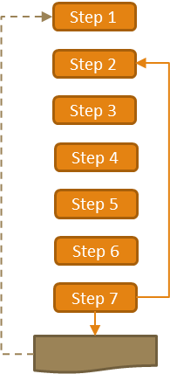
ADD Step 1
Review Inputs: Ensure the architecture drivers are available and correct
  Design Purpose – The goal of this round of Architectural Design
    Evaluate opportunities
    Design the foundation of the system
    Augment the current architecture
  Primary Functionality – Functionality that is critical to achieve the business goals
  Quality Attributes – Subset of QAs this round is focused on
    Derived from ASRs, focus on measurable or testable qualities (e.g., latency, security, etc)
  Constraints – Non-negotiable concerns
    e.g., existing systems, budget, etc
  Architectural Concerns – Things that need to be considered as part of the architectural design, often not captured by traditional requirements
    Overall System Structure
    Allocation of modules to teams
    Issues that come from design reviews
Design Purpose
Primary Functionality
Quality Attributes
Constraints
Architectural Concerns

Slide 17
ADD Step 1
Example – E-commerce
Purpose – design a foundation for an online-shop
Primary functionality – browsing & checkout
Quality attributes – scalability for holiday peaks
Constraints – must run on AWS
Concerns – payment and catalog will be created by different teams
  => potential communication issues
  => need to define clear APIs between these subsystems
Design Purpose
Primary Functionality
Quality Attributes
Constraints
Architectural Concerns

Slide 18
ADD Step 2
Establish Iteration Goal by Selecting Drivers
Waterfall is one round
  => goal is to finish all architectural activities
Iterative development (Agile) is multiple rounds
  => each round focuses on a specific goal
  Round 1
    greenfield system in a mature field – e.g., select the overall Reference Architecture
      e.g., monolith vs microservices
    greenfield system in a new, evolving field – e.g., develop a prototype architecture based on the key Drivers
      is it feasible at all?
    brownfield system – e.g., how the existing architecture extends to support the new functionality
  Later rounds may focus on a specific area – Security, Performance, etc. Where the specific area is based on the Drivers
  Summary – define the goal & select corresponding drivers (narrow your focus)

Slide 19
ADD Step 3
Choose One or More Elements of the System to Refine
Make the choice based on the chosen drivers
  Identify the elements that require additional refinement
  Potential types of refinement:
    Decomposition
      e.g., E-commerce – checkout pipeline – decompose into adding to basket, inventory check, payments, fraud detection
    Composition
      e.g., make “Logging” & “Monitoring” work together as a subsystem
    Improve / extend existing elements
      e.g., add auth via Instagram to the existing auth service
  First iteration
  Greenfield system - a system context diagram and refining / defining it
  Brownfield systems - may focus on what can be reused? Modified? Replaces

Slide 20
ADD Step 4
Choose One or More Design Concepts that Satisfy the Selected Drivers
  Step 3 – where, step 4 – how
  Make architectural choices
    Based on drivers
Sources of design concepts
  Reference Architectures – model architecture to solve a common problem
    e.g., a Client-Server model for providing a Web Service
  Architectural Design Patterns – conceptual solutions to reoccurring design problems
    e.g., layered architecture for separation of concern
    e.g., microservices for independent deployability
  Deployment Patterns – how to physically structure a system for deployment
    e.g., load balancing, CDN
  Tactics – decisions that influence quality attributes
    e.g., encrypt data in rest, caching, redundancy + failover

Slide 21
ADD Step 4
Choose One or More Design Concepts that Satisfy the Selected Drivers
  Step 3 – where, step 4 – how
  Make architectural choices
    Based on drivers
How to choose
  Traceability – does it serve the iteration goal?
  Feasibility – is it possible with current skills & tools?
    Complex solutions vs coding monkeys
  Cost/benefit – what about trade-offs?
    Microservices are great… but bring a lot of architectural complexity
  Combinability – is it compatible with another concept we may want to use?
  Risk management – how risky is it? Stay with low-risk solutions
    e.g., nobody on the team implemented that pattern before? What are pitfalls?

Slide 22
ADD Step 4
Choose One or More Design Concepts that Satisfy the Selected Drivers
  Step 3 – where, step 4 – how
  Make architectural choices
    Based on drivers
Example – E-commerce checkout subsystem
  Driver – performance under load
  Concepts:
    Reference architecture: 3-tier model (presentation, logic, data)
    Deployment patterns: load balanced cluster for a checkout service
    Tactic: caching inventory queries
  Result – high throughput, low latency
  Risks?
    Outdated inventory information due to caching
    Time between checkout & cache invalidation?

Slide 23
ADD Step 5
Instantiate Architectural Elements, Allocate Responsibilities and Define Interfaces
  Step 3 – choose elements, Step 4 – choose concepts, step 5 – apply in details
  E.g., chose microservices + API gateway, iteration 1
  API gateway – entry point & routing
  Order service – order lifecycle
  User service – profiles & auth
  Catalog service – products
  etc
  what interacts with what? How?
Some aspects can be clarified & changed on later iterations
  rate limiting in API gateway? Don’t know yet

Slide 24
ADD Step 6
Sketch Views and Record Design Decisions
Document it
  Ideas & whiteboard drawing => documentation & diagrams
  Document decisioning process
  Why:
    Do not forget yourself
    Share with other architects & engineers to explain
    Future architects & engineers will know the context

Slide 25
ADD Step 7
Analyze Current Design
Review the architecture against
  iteration goal
  drivers
  overall system goals
Drivers are met and the design purpose is satisfied? Victory!
Design purpose is not fulfilled? Next iteration
Iteration drivers are not met? Review the arch & next iteration to fix

Slide 26
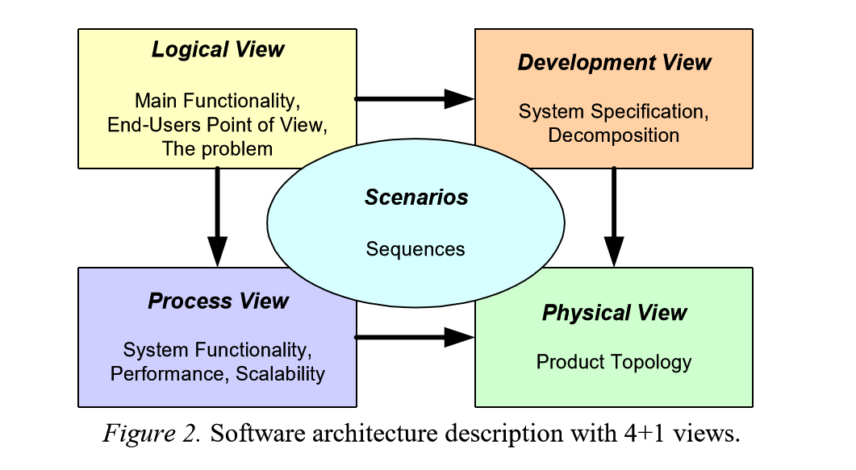
RUP 4+1 View
Arch cannot be expressed in one view
Logical
  Functionality – user’s PoV
  e.g., shopping cart, order, payment
  Stakeholders: analysts, designers, etc
Development
  Codebase organization
    Module decomposition
    Subsystems
    Libraries
    etc
  e.g., user-service, order-service
  Stakeholders: devs, config managers

Slide 27
RUP 4+1 View
Arch cannot be expressed in one view
Process
  Functioning in runtime
  Internal execution flow
  e.g., checkout flow
  Stakeholders: engineers, architects
Physical
  System topology / mapping to HW
  e.g., multi-datacenter setup
  Stakeholders: devops, engs, archs
Scenarios
  Use cases
  Tie 4 views together

Slide 28
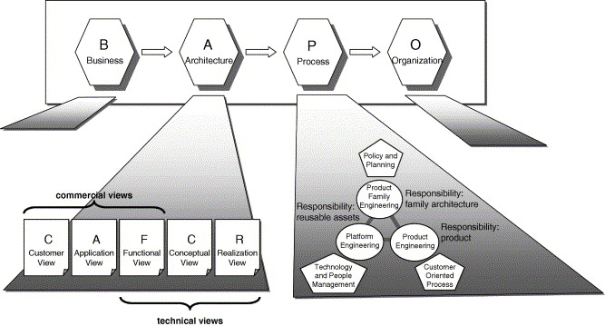
BAPO/ CAFCR
Why?
ADD & RUP 4+1 – focused on the technical aspect
Systems are created for businesses
  Business alignment
  Customer satisfaction
  Business processes
  etc

Slide 29
BAPO
Business – defines strategy / goals
  e.g., dominate the energy-efficient home device market
Architecture – translates those drivers into a system structure
  e.g., IoT thermostat with ML algos in the cloud
Process – defines arch evolving and implementation
  e.g., continuous deployment, rapid prototyping
Organization – who does the work + skills and roles
  e.g., IoT firmware team + devops team + ML experts
More high-level & business-oriented approach

Slide 30
CAFCR
Customer view – customer’s problem to solve
  e.g., wants to reduce electricity bills
Application view – in what context the product will exist
  e.g., IoT thermostat interacts with HVAC and smart home
Functional view – features
  e.g., auto temperature adjustment, remote control
Conceptual view – high-level architecture
  e.g., cloud-based ML, local device fallback
Realization view – implementation details
  e.g., microcontroller specs, deployment pipelines, etc

Slide 31
BAPO / CAFCR
Connected medical device
BAPO
  Business – regulatory compliance + patient trust
  Architecture – IoT + encryption + secure backend
  Process – strict verification
  Organization – compliance officers + dev team
CAFCR
  Customer need – track blood sugar easily
  Application – outside + doctor’s office
  Functional – measuring + real-time data sharing
  Conceptual – device + cloud sync + mobile app
  Realization – cell module + sim card + HIPAA-compliant backend

Slide 32
Product Delivery Process
Wider than initial architecture design
Pre-concept initiation
  What do we want to create / solve?
  Is it worth doing?
Concept initiation
  Shape a high-level solution
  Check it solves the need
  Check feasibility
Product initiation
  Establish metrics
  Validate feasibility by building a prototype
Development initiation
  Develop
Production / launch readiness
  Validate it’s ready
Launch / Wait
  Decision point – start or pause for fixes
Product validation
  Measure real-world performance
  Plan enhancements
Fleet upgrade / End-of-life
  Implement enhancements
  Discontinue

Slide 33
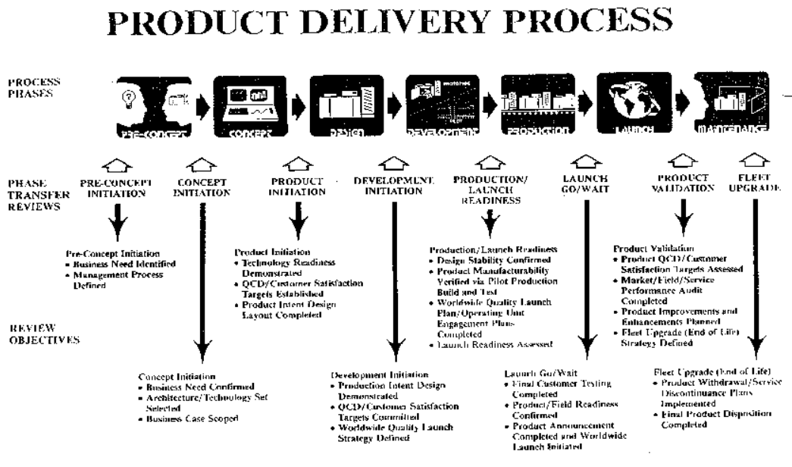
Notes:
Xerox Product Delivery Process, circa 1990s
Software Architecture was a dominant concern in the Concept Initiation and Product Initiation phases. Architecture would be well established by the start of Development.
Note the long lag time between identification of QCDs (Quality Targets) and validation.

Slide 34
Scenarios
Web application for banking
Describe a:
- Performance Attribute
- Security Attribute
- Integrity Attribute
- Availability Attribute
Control system for driverless car
Describe a:
- Performance Attribute
- Security Attribute
- Safety Attribute
- Reliability Attribute
What would be a good example of a Portability Attribute?
Notes:
web
Performance – N concurrent requests
Security – all connections via TLS 1.3
Integrity – crash => transaction rollback
Availability – 99.99%
Car
Performance – reaction < 50ms
Security – remote connections encrypted & signed
Safety – sensor fail => full stop
Reliability – 1000 hours between issues
Portability: Mobile app (iOS/ Android)

Slide 35
Examples
If you are building a desktop application
- Connects to online brokerage system
List some assumptions
List some dependencies
Notes:
Assumption: Have license to connect to brokerage system
Dependency: API documentation is available

